Slide 1
O365 Tenancy migration from McDonalds Global to local.
28 May 2024

Slide 2
AGENDA
1
2
3
4
Introduction / Background
Licensing
Migration requirements:
a. Users and Outlook
b. O365 Security requirements
c. Current Local PowerBI Installation
Open Discussion

Slide 3

Introduction / Background

Slide 4





Current Limitations But Not Limited To
Features | Option 1 – Corp Tenant | Option 2 – Own Tenant
One Drive | Currently cannot be used | Yes, Full Features
MS Team | All functions not enabled, only basic meeting and chat Missing major functions such as recording & auto meeting minutes taker using copilot | Yes, Full Features
Sharepoint | No Share Point Online available | Yes, Full Features
Microsoft Office | Only able to work locally, not able to share files online for collaboration | Yes, Full Features
Power BI | Limited functionality | Yes, Full Features

Slide 5

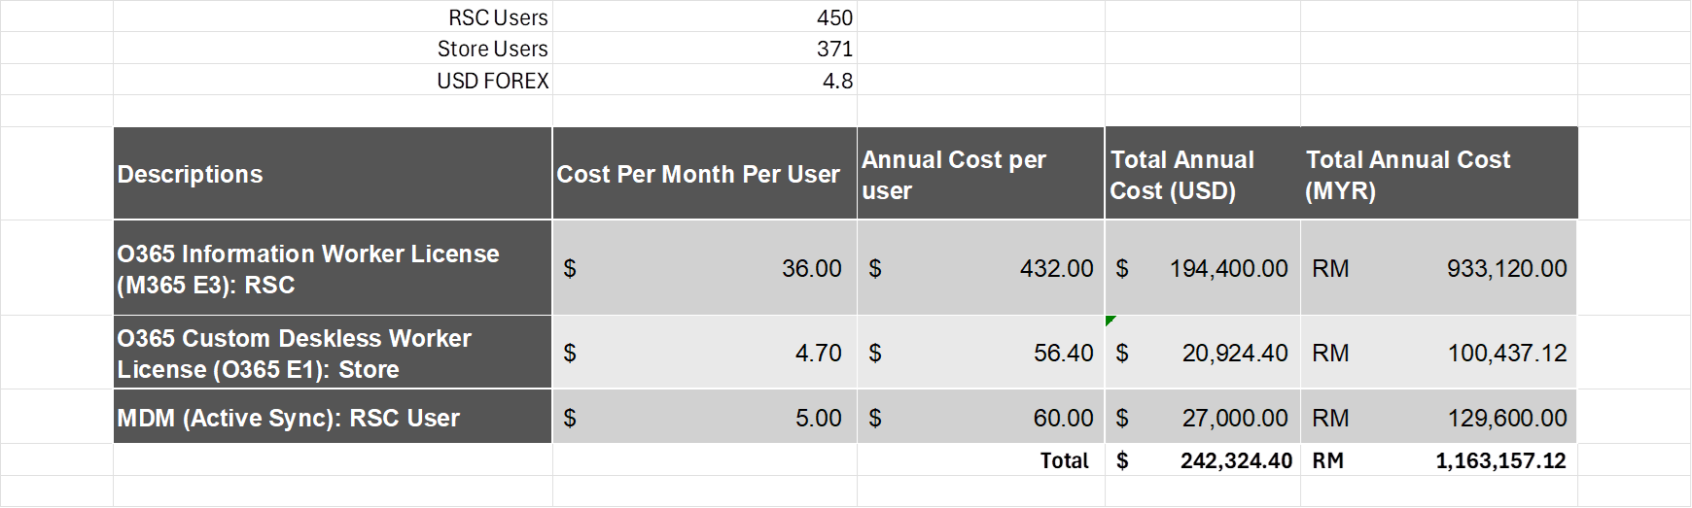
Estimated Number of users (License required)
Descriptions | No of Users
RSC Users:
M365 E5 | 450
PowerBI Premium | 25
Store Users:
O365 E1 | 371
PowerBI Pro | 400
* These are preliminary license number estimation and additional license requirements such as Sharepoint, Power Platform licenses to be discussed later

Slide 6
Open Discussion

Slide 7
Thank you

Slide 8
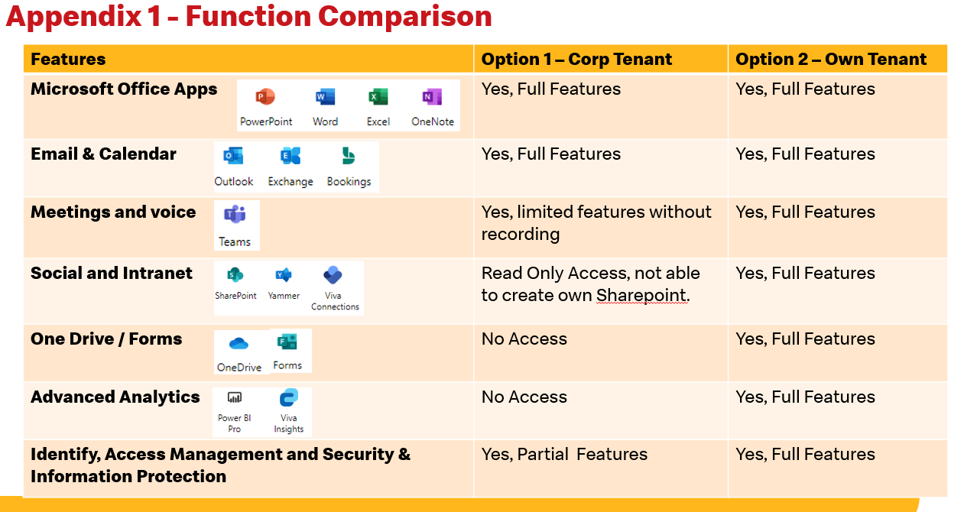
Functionality Comparison
No | Features | Product | Corporate Tenant | Own Tenant
1. | Microsoft Office Apps | Power BI Power Apps Power Automate | Limited features | Full Features
2. | Email & Calendar | Outlook Exchange Bookings | Full features | Full features
3. | Meetings & Voice | Teams | Limited features without recording | Full features
4. | Social & Intranet | SharePoint | Access: Read Only Unable to create own SharePoint | Full Features
5. | One Drive/Forms | OneDrive Forms | Do not have access | Full Features
6. | Advanced Analysis | Power BI Pro Viva Insights | Do not have access | Full Features
7. | Identify, Access Management and Security & Information Protection | Microsoft Access Management | Limited Features | Full Features

